Slide 1
Bacchus Winery
Orange Group CSD-310 12/11/2022

Slide 2
Introduction
Amanda Sherman
Michael B. Streed
Karendaysu Wolfe
Robin Pindel
Just a fun group of people trying to make it in this crazy world of children, adulting, and learning about software development.

Slide 3
Bacchus Winery Case Study
Steve and Davis Bacchus inherited the winery from their father and would like to incorporate new business methods to improve their products and customer service. The winery makes four types of wine - Merlot, Cabernet, Chablis, and Chardonnay - and sources their supplies from three distinct suppliers.
The Bacchus brothers are interested in modernizing and restructuring aspects of the business, including supply ordering and tracking, distributor ordering and tracking, and employee time tracking. This is where a database solution will come in handy.

Slide 4
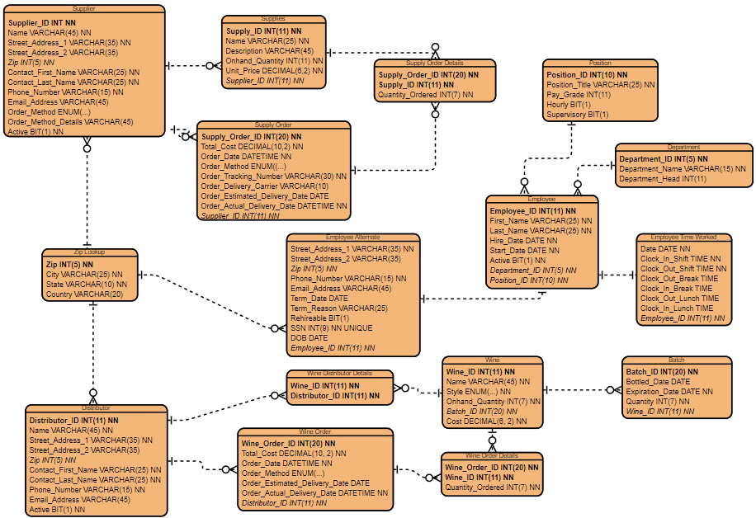
ERD

Slide 5
Report #1 - Employee Time
Stan and Davis Bacchus decided to keep all existing personnel and staff when they inherited the winery. They also wanted to make sure the employees felt minimal change during the turnover.
The employee time report can tell how long an employee worked on a certain day, they can keep monitor how many hours each employee is working. This will help them maintain consistent hours in scheduling their employees.

Slide 6
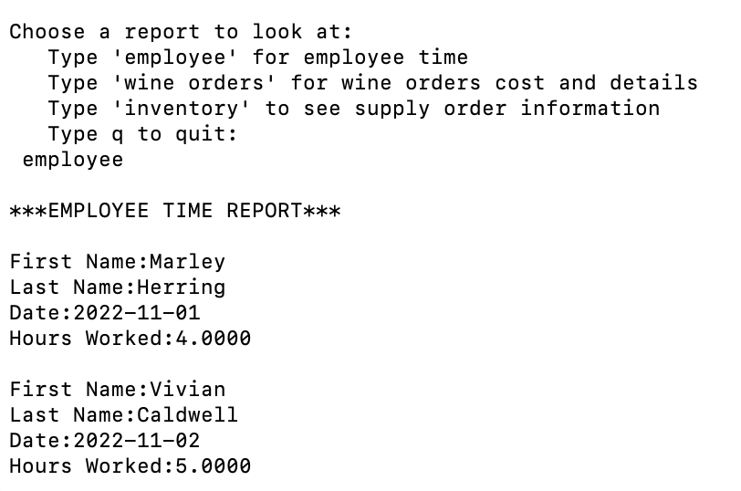
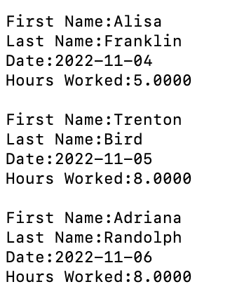
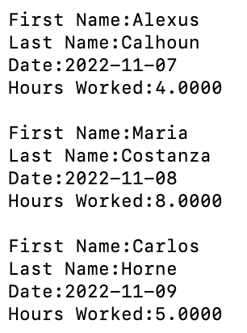
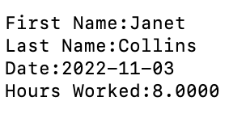
R
E
P
O
R
T
#1
D
A
T
A

Slide 7
Report #2 - Wine Orders
Stan and Davis would like to know which wines are selling, as well as the state of the inventory of the wine.
The wine orders report will tell them which wines are selling, the date sold and order id, how much the most recent order was, and quantity of the wine still on hand.

Slide 8
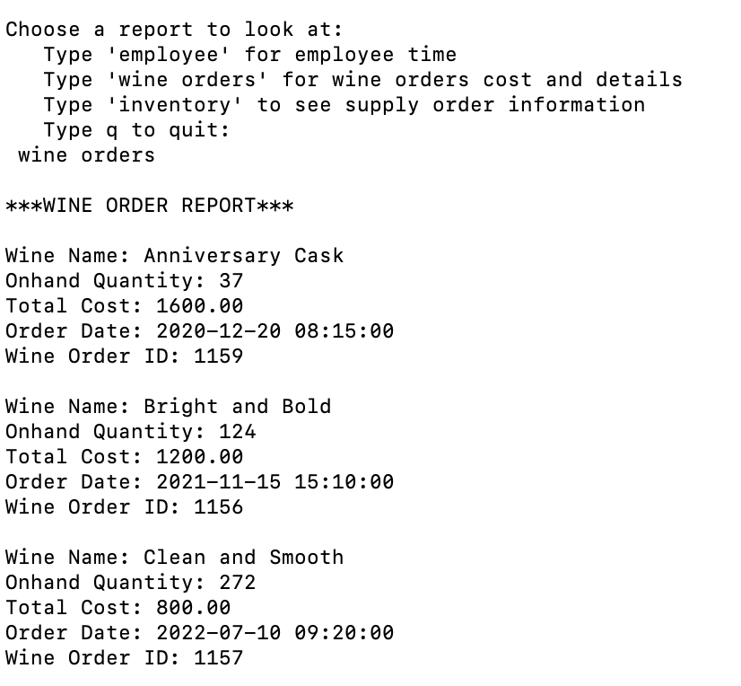
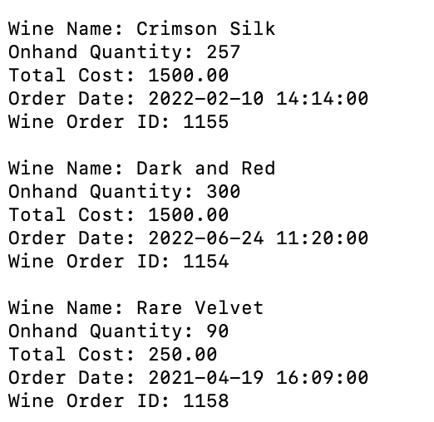
R
E
P
O
R
T
#2
D
A
T
A

Slide 9
Report #3 - Inventory
Stan and Davis would like an efficient way to monitor the supply orders and their cost. They would also like to monitor the estimated delivery date and actual delivery date of each of their orders.
The inventory report will show each supply order, the supplier, total cost, date ordered, estimated delivery date, and actual delivery date.

Slide 10
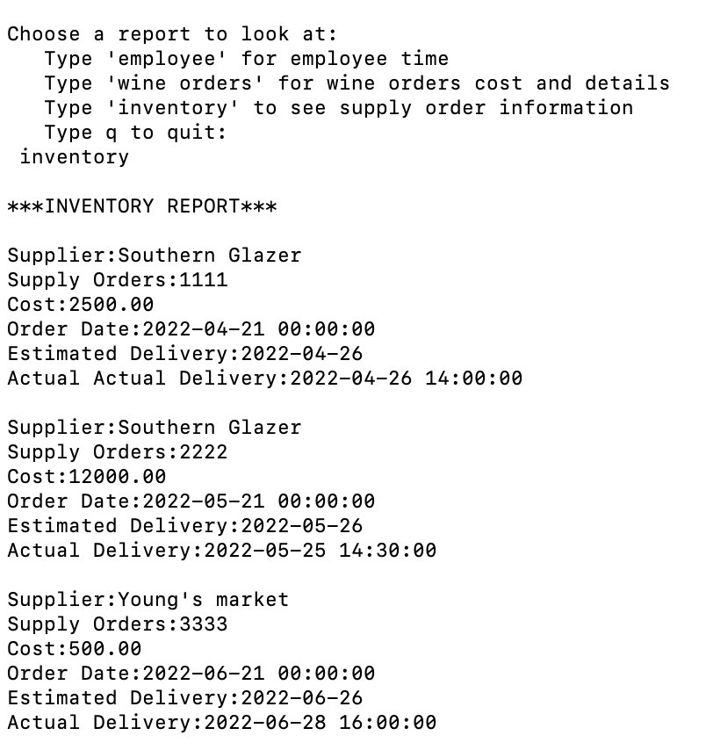
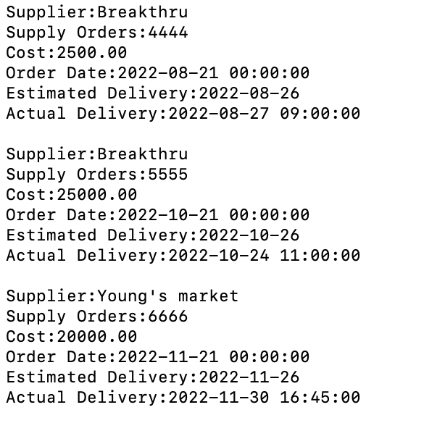
R
E
P
O
R
T
#3
D
A
T
A

Slide 11
Case Study Assumptions Made
Some assumptions that we made during the formation of our business rules which led to design choices were:
Each supply order can only include ONE supplier.
Many supplies can appear on MANY supply orders.
Suppliers have a contracted delivery ETA.
We later scrapped this data point.
Each wine order can only include ONE distributor.
Many wines can appear on MANY wine orders.
Employees work shifts with lengths that may require paid/unpaid breaks and/or lunches.
Each supply order has ONE tracking number and Bacchus Wine accepts full shipments only.
Each distributor (wine) order can have MANY tracking numbers and partial shipments are allowed.
Each wine can have MANY batches.

